Slide 1
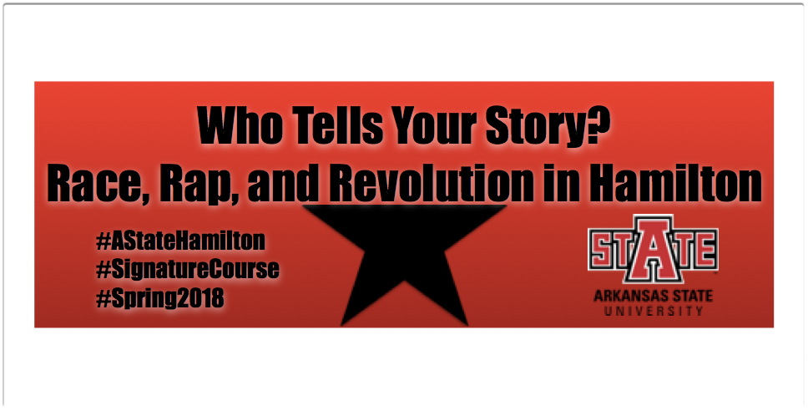

Interdisciplinary Collaboration

Slide 2
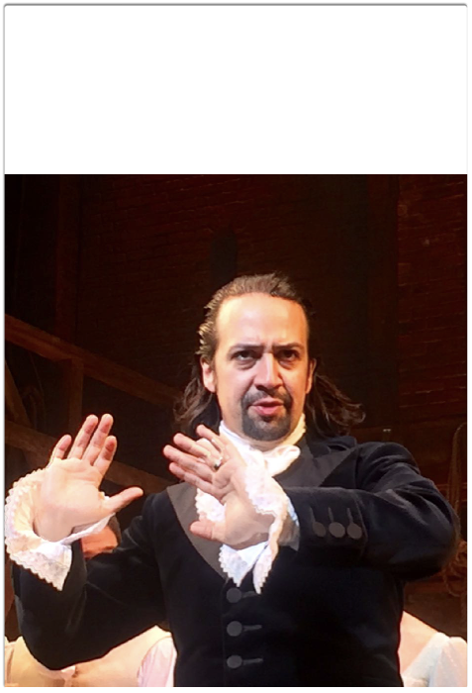
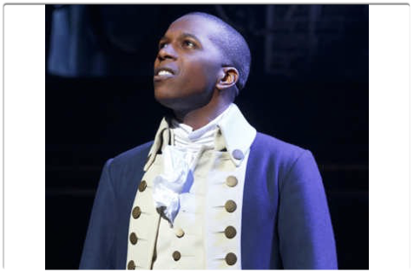
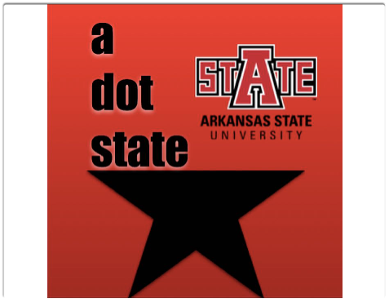
It started with an obsession…
and ended with a course.

Slide 3
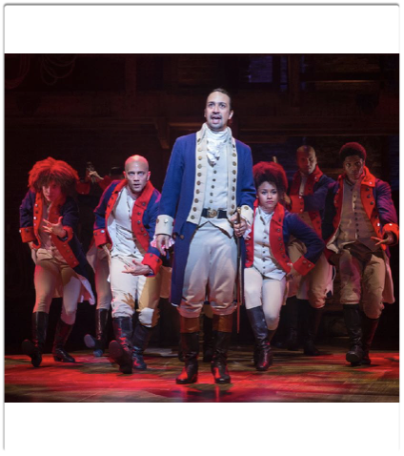
Who Tells Your Story? Race, Rap, and Revolution in Hamilton
Spring 2018
Team-taught by Lisa Bohn, Kristi Costello, Cherisse Jones-Branch, Sarah Mayberry Scott, and Carmen Williams
A-State’s inaugural Signature Course

Slide 4
What is a signature course?
Endorsed by Creative Commons, supporting innovative teaching & learning that is interdisciplinary and experiential-based.
  Integration of academic knowledge applied in a practical setting
  Interpersonal, communication, analytical, & organizational skills
  Knowledge of community and global solutions
  Demonstration of service-minded thinking

Slide 5
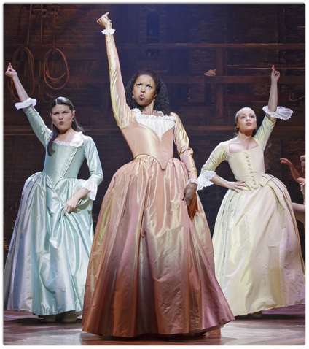
“Best of Wives, Best of Women”
Feminist rhetoric
Sarah Mayberry Scott
What does it mean to listen to women’s voices?
What are the elements of patriarchy at play?
How do these lend themselves toward advocacy for women?

Slide 6
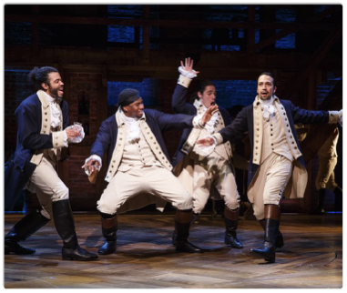
“Immigrants…we get the job done.” Race & Otherness
Carmen Williams
Immigrant, race, class are the anchors through which we examine:
  What is “difference”?
  What is the impact of “otherness”?
  Both questions in terms of the past vs. the present?

Slide 7
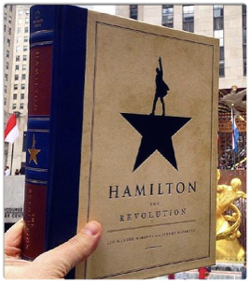
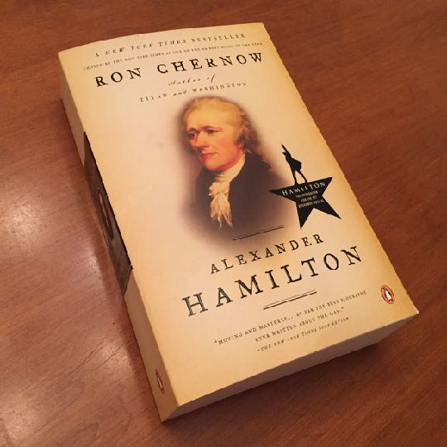
“Write Your Way Out”
Creative Nonfiction
Kristi Costello
What is at stake when we [re]write history?
What are the implications of Miranda’s dramatic license?
How does writing empower and give agency to people?

Slide 8

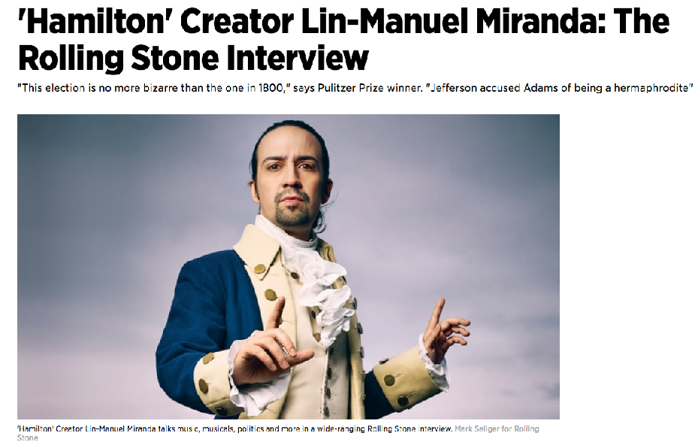
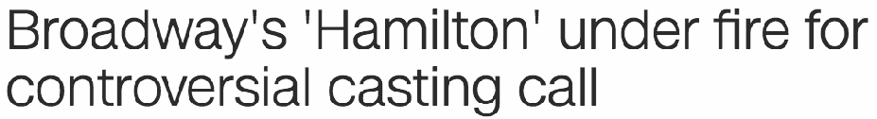
“What time is it? SHOWTIME!!” Theatrical elements
Lisa Bohn
What is the impact of cross-cultural casting?
How does musical theatre “legitimize” rap and hip hop music? And vice versa?
How does Hamilton make, break, and reinvent traditional musical theatre standards?

Slide 9
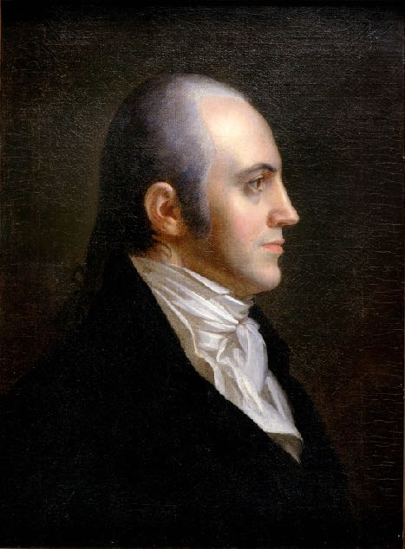
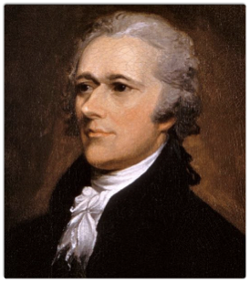
“HISTORY HAS ITS EYES ON YOU” HISTORICAL CONTEXT
Cherisse Jones-Branch
How did we create America?
Who is an American?
Hamilton and History: Are they in sync?
Who tells your story?

Slide 10
Yeah, but…*how*?
Journey chronologically through the musical, examining each song/scene from our individual perspectives as appropriate
Collaborative learning & classroom activities that enhance students’ critical and creative thinking skills
Culminating project that tells the story of a marginalized group in the NEA area
Strong use of digital and mobile technology in class

Slide 11




Final thoughts…
Class will be cross-listed in each department; please encourage your advisees to consider it (3000-level) as an upper-level elective
Find opportunities to collaborate across campus
If anyone knows Lin-Manuel Miranda personally, we would love to give him a call.
Follow us! @astatehamilton

